Slide 1
HUD Office of Community
Planning and Development
Remote Monitoring
Notes:
Welcome

Slide 2
Agenda
  Pre-Monitoring
    Risk Analysis
    Monitoring Strategy
    Monitoring Exhibits
    Monitoring Notification Letter
    Grantee Document Exchange (GDX)
  Conducting Remote Monitoring
    Entrance Conference
    Interviews
    Meetings/Q&A
    Exit Conference
  Post Monitoring
    Monitoring Letter and Report
    Follow-up
s
Notes:
Here is a quick look at our agenda. We’ll begin by providing a brief overview of the PR-26 reports, cover the two compliance tests required for planning and admin funds, discuss techniques for reviewing, reconciling and correcting PR-26 reports. We are also going to cover some common issues with the PR-26 and how to resolve them, and discuss the financial summary evaluation tool.

Slide 3
Purpose of Monitoring
Why does HUD conduct monitoring?
  Determine compliance,
  Prevent and identify deficiencies,
  Design corrective actions to improve or reinforce grantee performance, and
  Provide opportunities to identify grantee best practices.

Slide 4
In-depth Monitoring
A detailed compliance review for a selected grantee;
A concentrated review of specific activities, projects or programs; and/or
A review of known high-risk areas or critical functions.

Slide 5
Remote Monitoring
Conducted off-site
Based upon analysis of information from the grantee, including interviews
Information forming the basis for remote monitoring conclusions can incorporate review of performance reports and audited financial statements, information in databases, and other documentation submitted by the grantee
***SAME PROCESS AS ON-SITE MONITORING***

Slide 6
Pre-Monitoring
  Conduct Risk Analysis
  Develop Monitoring Strategy
  Select Monitoring Exhibits
  Send-out Monitoring Notification Letter
  Grantee submits data via the Grantee Document Exchange (GDX)

Slide 7
Risk Analysis
All HUD CPD programs are assessed annually to determine risk, based on a set of factors. Based on a 100-point rating scale, grantees are assigned one of three risk categories:
  High risk – a total score of 51 or more
  Medium risk – a score between 30–50
  Low risk – a score of less than 30

Slide 8
Monitoring Strategy
Review Consolidated Plan and Annual Action Plan
Review Consolidated Annual Performance and Evaluation Report (CAPER)
Review Annual Performance Reports (APRs)
Review any open activities and grant progress
Review any open findings from previous HUD monitoring and/or OIG Audit
Consider any other unresolved or on-going grantee issues

Slide 9
Monitoring Exhibits
COMMONLY USED MONITORING EXHIBITS
CHAPTER 3: COMMUNITY DEVELOPMENT BLOCK GRANT (CDBG) ENTITLEMENT, SMALL CITIES, NON ENTITLEMENT CDBG GRANTS IN HAWAII, AND INSULAR AREAS PROGRAMS
CHAPTER 4: STATE COMMUNITY DEVELOPMENT BLOCK GRANT (CDBG) PROGRAM
CHAPTER 7: HOME INVESTMENT PARTNERSHIPS PROGRAM (HOME)
CHAPTER 28: EMERGENCY SOLUTIONS GRANTS (ESG) PROGRAM
CHAPTER 29: CONTINUUM OF CARE (CoC) PROGRAM
CHAPTER 34: 2 CFR PART 200, UNIFORM ADMINISTRATIVE REQUIREMENTS, COST PRINCIPLES, AND AUDIT REQUIREMENTS FOR FEDERAL AWARDS
CHAPTER 22: FAIR HOUSING AND EQUAL OPPORTUNITY
CHAPTER 24: LEAD-BASED PAINT COMPLIANCE

Slide 10
Monitoring Notification Letter

Slide 13
HUD Grantee Document Exchange (GDX)
What is HUD GDX?
The Grantee Document Exchange (GDX) is an external, secure platform outside of the HUD firewall that lets HUD share documents from a monitoring session and build a list of documents related to the monitoring so that grantee users from other systems can log on and submit requested documents along with notes.
GDX Log-In*: https://drgr.hud.gov/gdx/
*It is important that all users open application in Chrome or Edge and do not use outdated and unsupported browsers such as Internet Explorer.

Slide 14
GDX (continued)
Grantees access shared documents and/or bundles through an externally-accessible portal application
    GDX portal only displays those sessions for which documents have been requested or where documents have been shared
    GDX user sees shared documents and request bundles categorized by monitoring session start and end dates
    Grantee responds to requests in the bundle; Bundle response not viewable by HUD until sent. Once completed, grantee sends its response bundle to HUD for review.
    GDX accessible only by grantees.

Slide 15
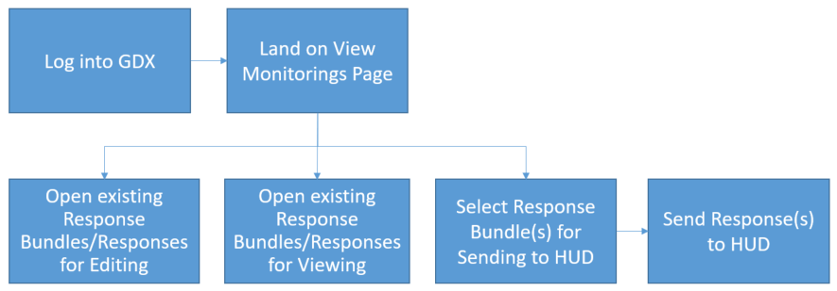
GDX (continued)
When a document request has been sent to a grantee with the link, they can log into GDX to see their request bundles. Grantees will have edit rights for their request bundles until they have been submitted to HUD.
Once submitted to HUD, those bundles become view only so make sure to include all documents requested if possible. If HUD indicates there is a document still needed at that point, they will have to create a new bundle.

Slide 16
Conducting Remote Monitoring
  Entrance Conference
  Interviews
  Meetings/Q&A
  Exit Conference

Slide 17
Entrance Conference
What happens at the entrance conference?
  Staff introductions
  Discuss Risk process and why grantee was selected for monitoring
  Identify/confirm key grantee staff who will assist during the monitoring
  Review the program areas/activities to be monitored
  Set-up or confirm meeting or interview times
  Discuss any opportunity for T.A.
  Discuss any challenges

Slide 18
Interviews with Staff
Interviews with grantee staff are conducted throughout the monitoring week, based on the program area being reviewed.
Interviews are also scheduled with subrecipients and clients, to clarify and determine the accuracy of the information, assess level of satisfaction with the provision of services or the “end products,” and document performance.
Interviews are scheduled via Teams, conference call-in numbers, or telephone.

Slide 19
Interviews with Staff (continued)
Grantee staff should be prepared to:
Respond to questions on the monitoring exhibits,
Be able to provide justification for responses,
Be available to answer any questions the HUD reviewer may have, and
Be prepared to provide any additional information and documentation requested by the HUD reviewer.

Slide 20
Daily Q&A Meetings
Throughout the monitoring, it is important to communicate and keep an on-going dialogue with the HUD reviewer.
The HUD reviewer will set-aside some time each day to:
    Check-in with staff and discuss monitoring progress,
    Discuss any problem areas encountered to provide grantee staff an opportunity to make “on-the-spot” adjustments or corrections, and
    Answer any questions grantee staff may have.

Slide 21
Exit Conference
Review the monitoring results with grantee staff:
  Discuss any preliminary findings or concerns
  Discuss the difference between a finding and a concern
  Make recommendations for program improvement
  Allow time for questions
Discuss next steps:
  Monitoring letter and report
  FHEO, LBP, and other area input
  Technical assistance and other resources
  Remind the grantee that HUD is available for questions, after the exit conference

Slide 22
Post-Monitoring
  Monitoring Letter and Report
  Follow-up

Slide 23
Monitoring Letter and Report
  Monitoring letter and report go to the grantee within 60 days after the exit conference.
  Report clearly describes the results of the monitoring, including areas covered and basis for conclusions.
  Report identifies findings and concerns.
  Due dates to respond to findings are included with corrective actions.
  If there are findings, opportunity for grantee to submit additional information regarding findings to demonstrate compliance with the requirements.
  Identify any fair housing or civil rights related issue that gets referred to FHEO.
  Outlines any technical assistance provided during monitoring.

Slide 24
Follow-up
  Grantee has 30 days to respond to the monitoring report.
  Post-monitoring and on-going technical assistance is provided to the grantee to maintain or improve performance.
  Follow-up is done to ensure corrective actions are implemented.
  Close-out findings.

Slide 25
Monitoring Tools
CPD’s most current risk analysis notice: Notice CPD-2014-04: https://files.hudexchange.info/resources/documents/Notice-CPD-14-04-Risk-Analyses-Monitoring-CPD-FY-2015-2016.pdf
The monitoring policies and processes in Handbook 6509.2, CPD Monitoring Handbook: https://www.hudexchange.info/resource/290/hud-community-planning-and-development-monitoring-handbook-65092-rev7/

